Slide 1
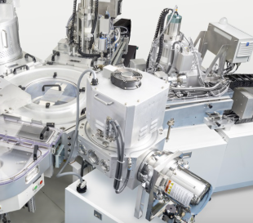
Success in Action | Semiconductor OEM
Customer Application
Precision temperature control in semiconductor tools, where accuracy and cleanliness are mission-critical.
Customer Challenge
DwyerOmega Solution
Needed high-performance temperature sensors with strict tolerances, EMI protection, and tool-specific configurations, and fast delivery.
Product: RTDs & Thermocouples
Custom bends & tolerances
Torque-specified fittings
Drain wire attachments
EMI grounding & special labeling
Fast quotes, expert support, and design flexibility made us the go-to partner.
Customer Information
Opportunity Value
Global semiconductor OEM known for innovation and precision
Demands strict spec adherence for wafer processing
Operates across multiple specialized areas
Multi-year, 7-figure value with ongoing design wins across tool platforms.
25% of their orders from DwyerOmega are custom designs

