Slide 1
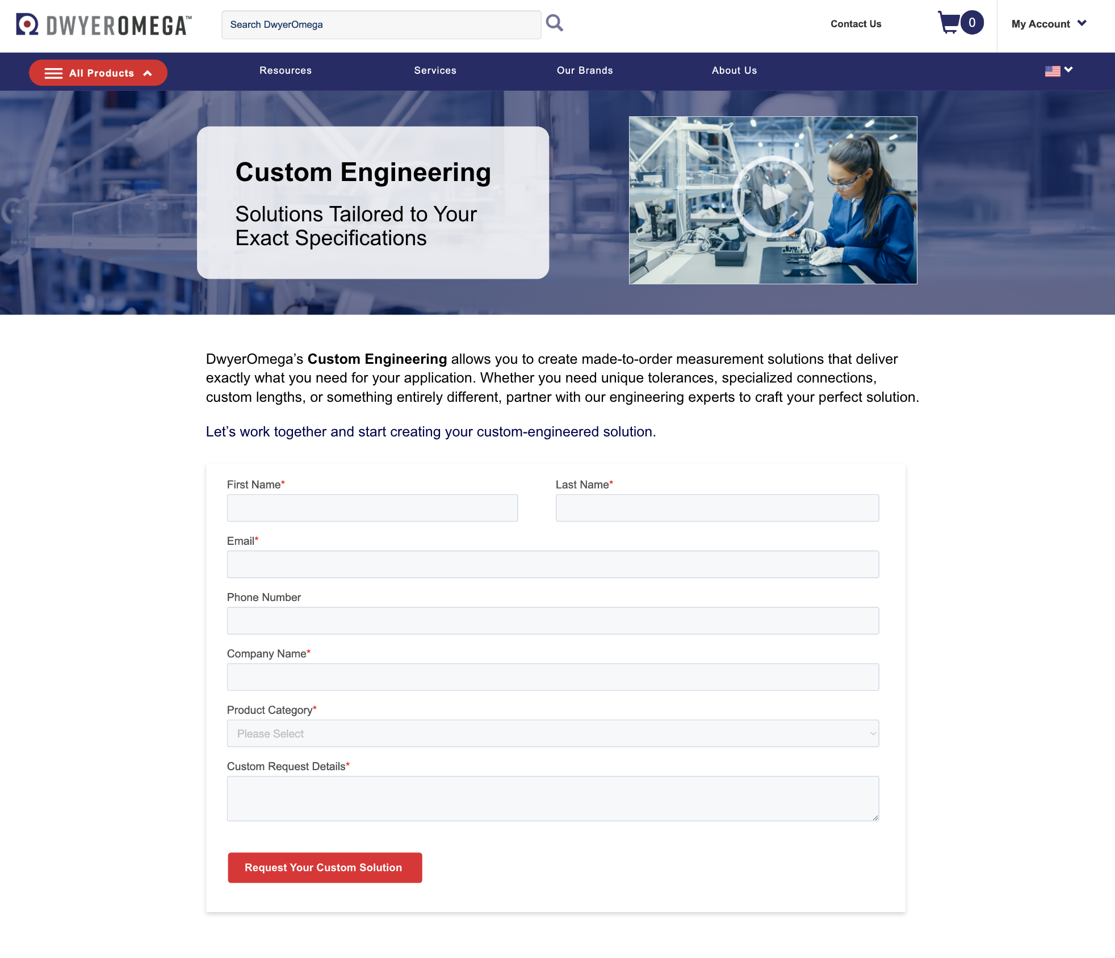
Custom Engineering
Solutions tailored to your exact specifications
Made-to-order measurement solutions that deliver exactly what you need
  Unique tolerances
  Specialized connections
  Labeling
  Probe bends
  Power ratings
  or something entirely different...
Typical production: 3-6 weeks
dwyeromega.com/en-us/custom-engineering
Notes:
Custom lengths, unique tolerances, specialized connections, specific labeling, or something entirely different.....
All Products, particularly Temperature, Pressure, Force, Flow, & Heaters
Quotes typically delivered in 1-4 weeks

